Slide 1
Machine Learning -
Basic Principles & Practice
5. From Lazy Learning to
Eager Learning
机器学习 - 基础原理与实践
5. 从临阵磨枪到积极学习
Cong Li 李聪

Slide 2
Lazy Learning 临阵磨枪
Rote Learning & Nearest Neighbor死记硬背和最近邻
  Memorize all the training data in learning 在学习时记住所有的训练数据
    Nothing else 没有其他的了
It’s Lazy 这很懒惰
  Meaningful work done in classification 有意义的事情都是分类时做的

Slide 3
Lazy Learning Characteristics
临阵磨枪的特点
No Explicit Knowledge Learned 没有学习到显式的知识
  Classification complexity depends on data 分类的复杂程度由数据决定
    Can either be good or bad
    这有时是好事，有时是坏事
Slow in Classification 分类很慢
  Have to go through all the data 必须遍历所有的数据

Slide 4
Eager Learning 积极学习
Learn beyond Memorizing
超越记忆的学习
  Do more in training 训练时做得更多
  Learn a certain explicit knowledge representation 学习到了特定的显式知识表示
Let’s Start from Linear Classifiers
让我们从线性分类器开始

Slide 5
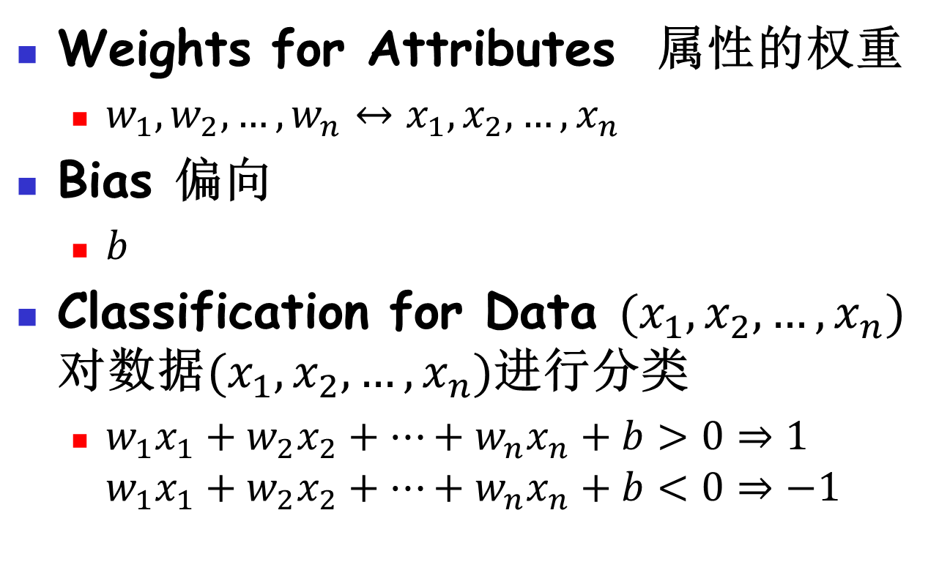
Explicit Knowledge 显式的知识
Weights for Attributes 属性的权重
  $w_{1},w_{2},…,w_{n}↔x_{1},x_{2},…,x_{n}$
Bias 偏向
  $b$
Classification for Data ${(x}_{1},x_{2},…,x_{n})$ 对数据${(x}_{1},x_{2},…,x_{n})$进行分类
  $w_{1}x_{1}+w_{2}x_{2}+…+w_{n}x_{n}+b>0⇒1$
  $w_{1}x_{1}+w_{2}x_{2}+…+w_{n}x_{n}+b<0⇒−1$

Slide 6


2D Example 二维的示例
  Attribute 2 属性2
$$2x_{1}−4x_{2}+6=0$$
(-2,1)
$$2⋅\left(−2\right)−4⋅1+6=−2<0$$
  Attribute 1
  属性1

Slide 7

2D Example 二维的示例
  Attribute 2 属性2
$$2x_{1}−4x_{2}+6=0$$
(-2,1)
$$2⋅0.5−4⋅1.5+6=1>0$$
(0.5,1.5)
  Attribute 1
  属性1

Slide 8
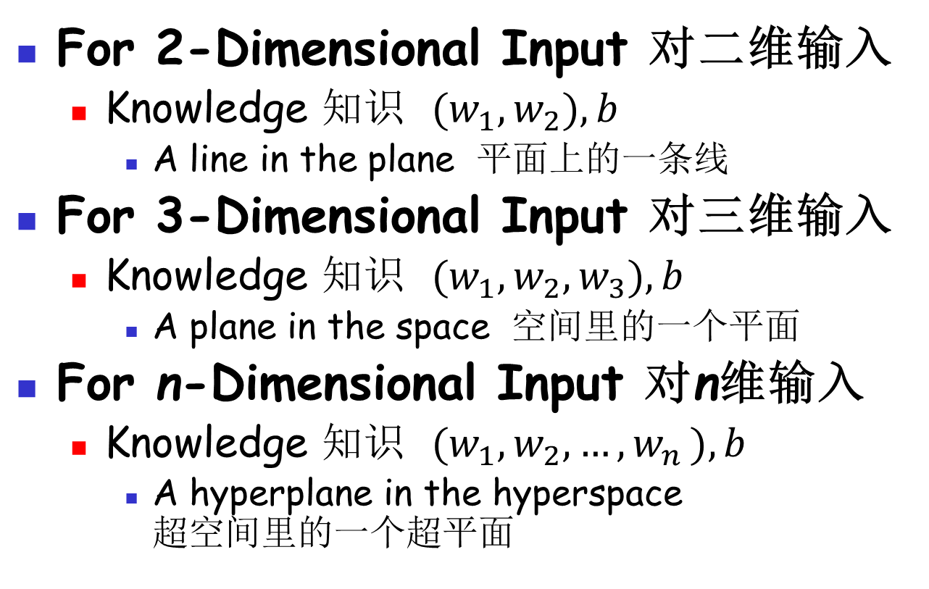
Linear Classifier 线性分类器
For 2-Dimensional Input 对二维输入
  Knowledge 知识 ${(w}_{1},w_{2}),b$
    A line in the plane 平面上的一条线
For 3-Dimensional Input 对三维输入
  Knowledge 知识 ${(w}_{1},w_{2},w_{3}),b$
    A plane in the space 空间里的一个平面
For n-Dimensional Input 对n维输入
  Knowledge 知识 ${(w}_{1},w_{2},{…,w}_{n}),b$
    A hyperplane in the hyperspace
    超空间里的一个超平面

Slide 9
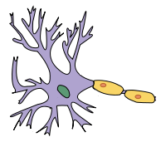
Biological View 生物学的视角
Neuron 神经细胞
Dendrites: receiving incoming signals
树突：接收外来信号
Nucleus: processing signals
细胞核：信号处理
Axon: sending outgoing signals
突触：对外发送信号

Slide 10


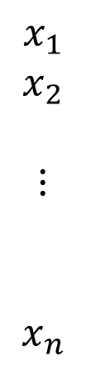
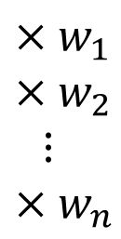


Linear Classifier as a Neuron
作为神经细胞的线性分类器
$$x_{1}$$
$$x_{2}$$
$$⋮$$
$$x_{n}$$
$${×w}_{1}$$
$${×w}_{2}$$
$$⋮$$
$${×w}_{n}$$
$$−b$$
$$w_{1}x_{1}+w_{2}x_{2}+…+w_{n}x_{n}$$
$$−(−b)$$
?
$$>0$$

Slide 11
How to Learn? 怎么学？
Paradigm: Online Learning
模式：在线学习
  Each time, classify a certain data item w/ the current classifier 每一时刻，用当前分类器对一个数据进行分类
  Compare the classification result w/ the ground truth 比较分类结果和真实类别
  Adjust the classifier 调整分类器
Perceptron Algorithm 感知器算法

Slide 12
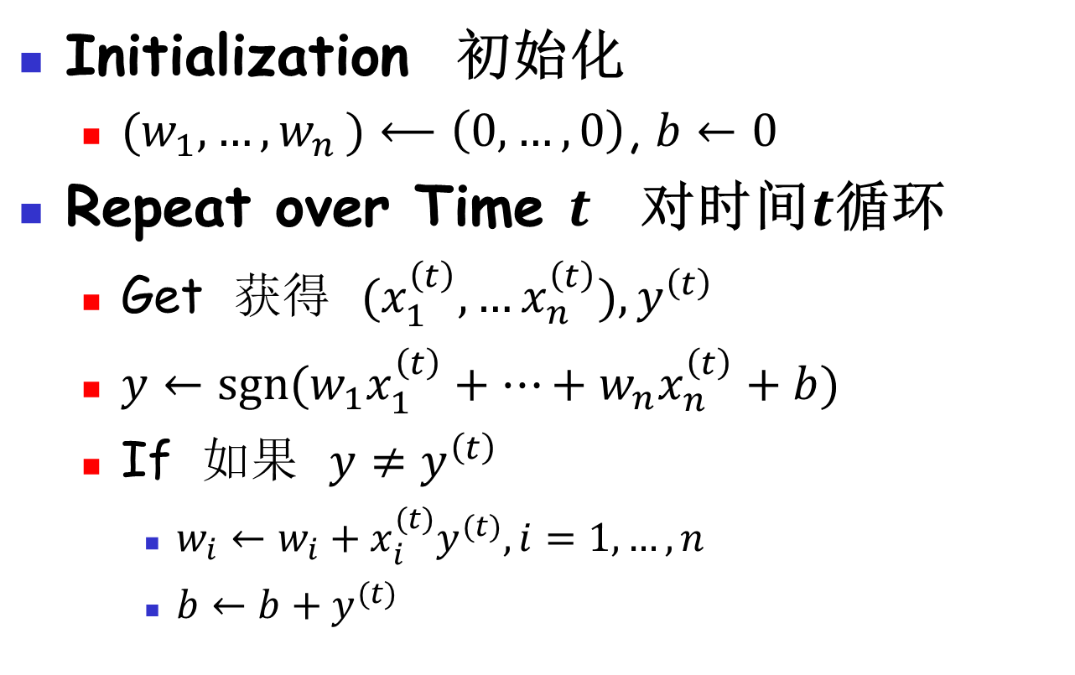
Perceptron Algorithm
感知器算法
Initialization 初始化
  ${(w}_{1}, {…,w}_{n})⟵\left(0,…,0\right)$, $b←0$
Repeat over Time $t$ 对时间$t$循环
  Get 获得 $(x_{1}^{\left(t\right)},…x_{n}^{\left(t\right)}),y^{\left(t\right)}$
  $y←sgn⁡(w_{1}x_{1}^{\left(t\right)}+…+w_{n}x_{n}^{\left(t\right)}+b)$
  If 如果 $y≠y^{\left(t\right)}$
    $w_{i}←w_{i}+x_{i}^{(t)}y^{(t)},i=1,…,n$
    $b←b+y^{(t)}$

Slide 13
Batch Learning 批量学习
Typical Case: Not the Online One
典型的情况：并非在线学习
  Repeatedly loop over the dataset
  反复对数据集进行循环
Stop Conditions 结束条件
  Stop learning if no errors in a batch
  如果一轮中没有出错，就可以结束学习
  Otherwise? 否则呢？
    Make it simple, stop after a maximum number of rounds 简单点：到达最大轮数终止

Slide 14

Practice 5.1 实践5.1
Practice time: use perceptron on the 1-attribute & 2-attribute synthetic problems
实践时刻：将感知器用于一个属性和两个属性的人造问题
Compare the results w/ those from nearest neighbor
和最近邻的结果进行比较

Slide 15
Result 结果
Perceptron performs stably, but why?
感知器表现得很稳定，这是为什么？

Slide 16

Do You Still Remember?
你还记得吗？
  No assumption, no learning!
  无假设，不学习！
  Now where is the assumption?
  那么假设在哪里？

Slide 17
Assumption 假设
Assumption 假设
  Classification can be done w/ a hyperplane 能用一个超平面完成分类
Perceptron Algorithm 感知器算法
  If there exists a hyperplane separating the 2 classes, perceptron guarantees to find such a hyperplane
  如果存在一个划分两类的超平面，那么感知器也能找到一个这样的超平面

Slide 18
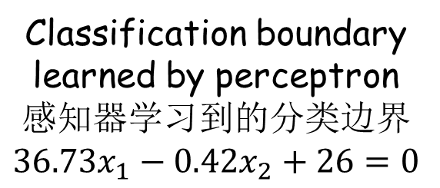
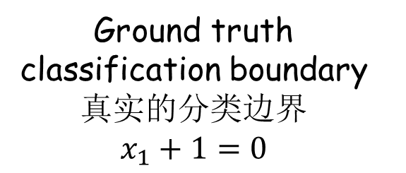
Synthetic Problem 人造问题
Ground truth classification boundary 真实的分类边界
$x_{1}+1=0$
Classification boundary learned by perceptron 感知器学习到的分类边界
$36.73x_{1}−0.42x_{2}+26=0$

Slide 19
Assumption Holds 假设成立
This Synthetic Problem 该人造问题
  Assumption holds 假设成立
    Hyperplane separates the data
    超平面分割了数据
How about Real World Problem?
真实的问题如何？
  Like word sense disambiguation for ‘interest’ 例如“interest”的词义消歧
    Wait, this is a multi-class problem
    等一下，这个是多类问题

Slide 20
Multi-class Linear Classifier
多类线性分类器
Linear Classifier 线性分类器
  Hyperplane splits data into 2 parts
  超平面将数据一分为二
Given More than 2 Classes
当多于两个类别时
  Construct multiple linear classifiers
  创建多个线性分类器
    Each classifier: one vs. rest
    每个分类器：一对其余

Slide 21
One vs. Rest 一对其余
Classifier
分类器

Slide 22
One vs. Rest 一对其余
Classifier
分类器

Slide 23
One vs. Rest 一对其余
Classifier
分类器

Slide 24



Compete w/ the Score 比较得分
$$w_{1}x_{1}^{\left(t\right)}+…+w_{n}x_{n}^{\left(t\right)}+b$$
Classifier
分类器
$$w_{1}x_{1}^{\left(t\right)}+…+w_{n}x_{n}^{\left(t\right)}+b$$
Data 数据
Classifier
分类器
Compete 比较
$$w_{1}x_{1}^{\left(t\right)}+…+w_{n}x_{n}^{\left(t\right)}+b$$
Classifier
分类器

Slide 25
Practice 5.2 实践5.2
Practice time: use perceptron on word sense disambiguation
实践时刻：将感知器用于词义消歧
Compare the results w/ those from nearest neighbor
和最近邻的结果进行比较

Slide 26
Result 结果
Perceptron improves the accuracy a lot
感知器大幅提升了准确率

Slide 27
The End

